Slide 1
“The Internet of Things is coming, and you better disrupt or prepare to be disrupted.”
- PC magazine

Slide 2
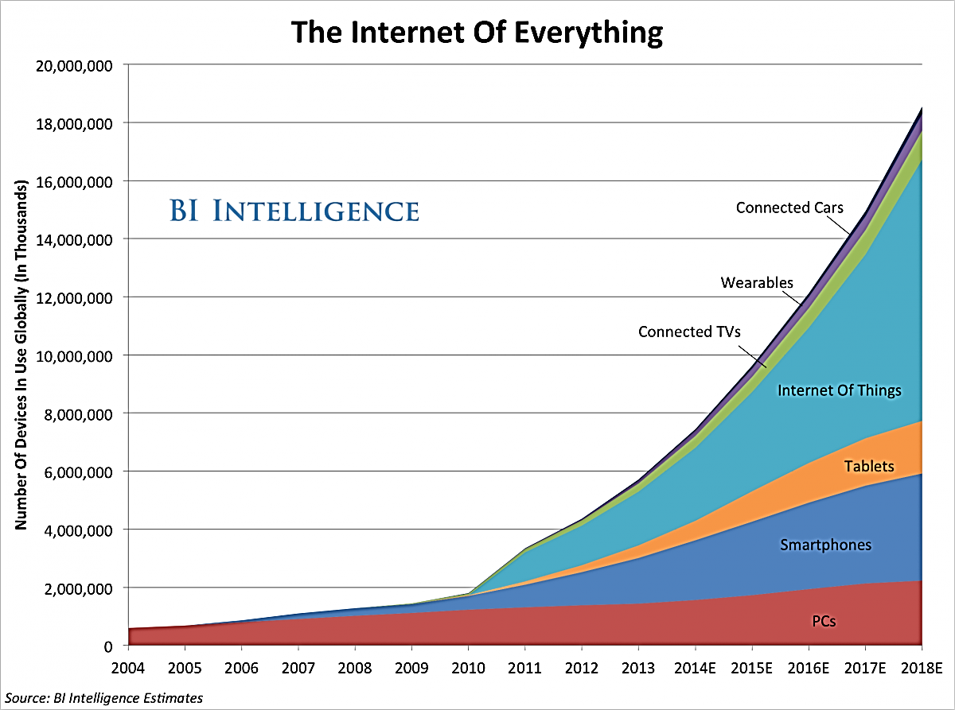
The smart phone was big, the IoT is going to be a lot bigger..
http://www.businessinsider.in/THE-INTERNET-OF-EVERYTHING-2014-SLIDE-DECK/articleshow/31124349.cms

Slide 3
“Time has come to implement IoT beyond home automation.” - unknown

Slide 4


Slide 5


Slide 6


Slide 7

Follow Me Trolley

Slide 8
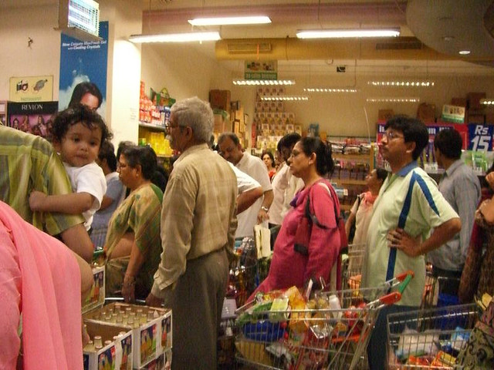

Slide 9
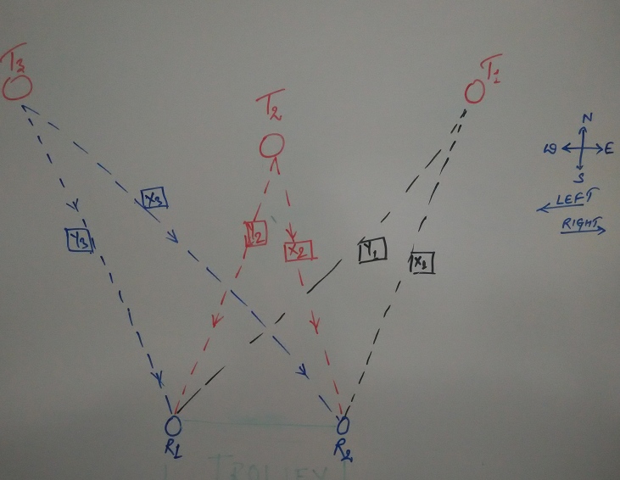
Concept

Slide 10
Hardware
Ultrasonic Sensor – 4
Bluetooth Sensor – 2
BO Motor – 2, Stepper Motor Driver - 1
BO Small Wheel - 2
Caster Wheel – 1
Arduino UNO – 2, Node MCU – 1
RFID Sensor – 1
Buzzer – 1
Jumper Cables, Bread Boards
9V DC - 4

Slide 11
Software
Azure IoT Hub
Angular JS – Front End
Web API 2
C# 6.0
SQL Server
Embedded C
Serial AT Commands
MQTT / HTTP

Slide 12
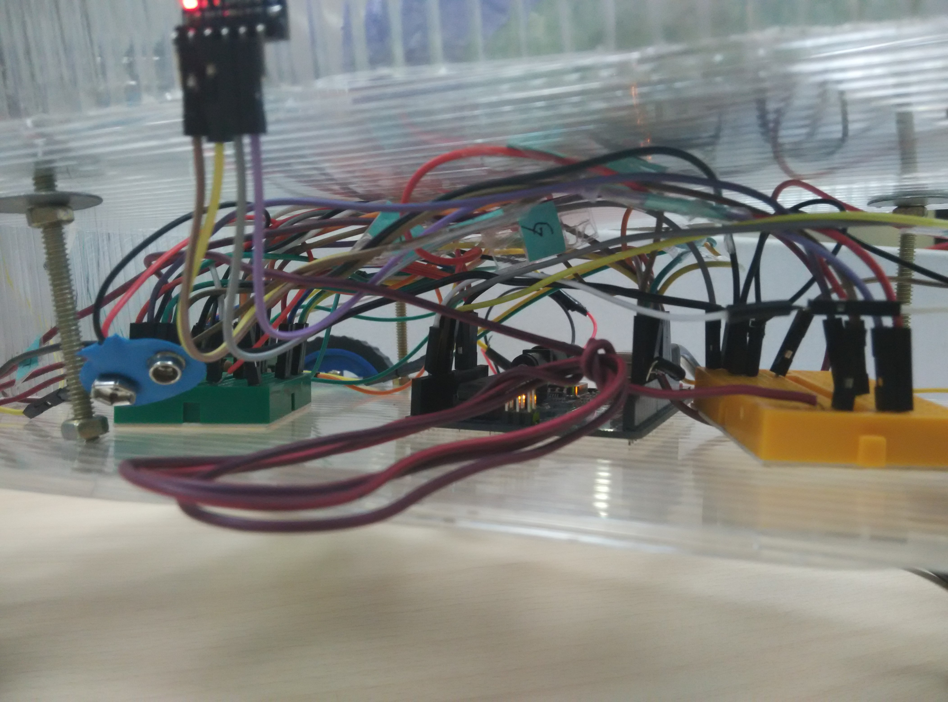

Slide 13
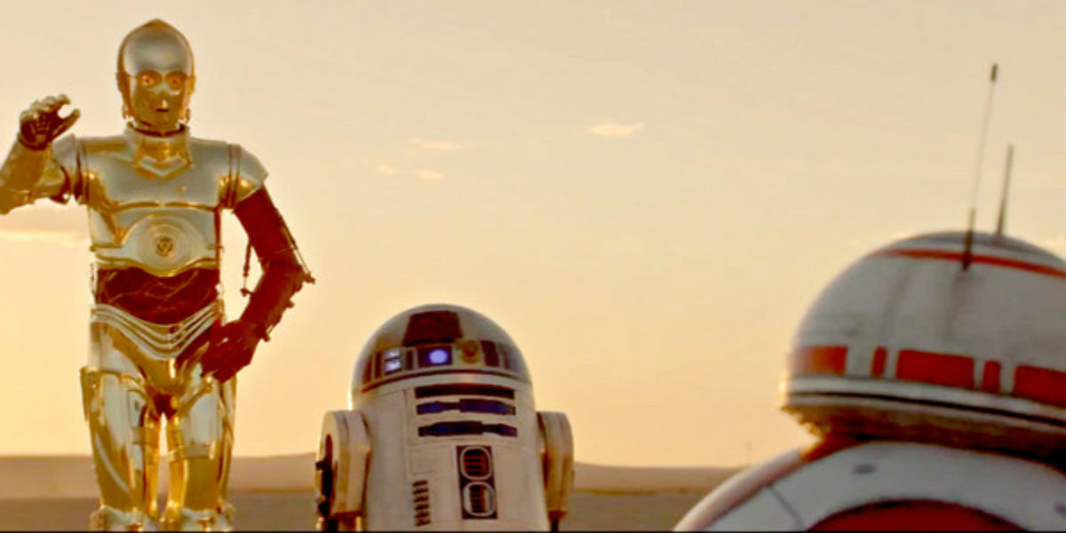
Thank You !

